Slide 1
SOFTWARE ENGINEERING
Elicitation Techniques
By
Israr Ahmad

Slide 2
Elicitation Techniques
Traditional:Document Reading, Interviews, Questionnaires
Group:Requirements-workshops, Brainstorming
Artifact based: Storyboards, Prototypes
Contextual (social): Ethno-methodology, observation.

Slide 3
Traditional: Document Reading
Sources of information:
Company reports, organization charts, policy manuals, job descriptions, reports, documentation of existing systems, SOPs etc.
Advantages:
  Helps you get an understanding of an organization before meeting the people who work there.
  Helps to prepare for other types of fact finding

Slide 4
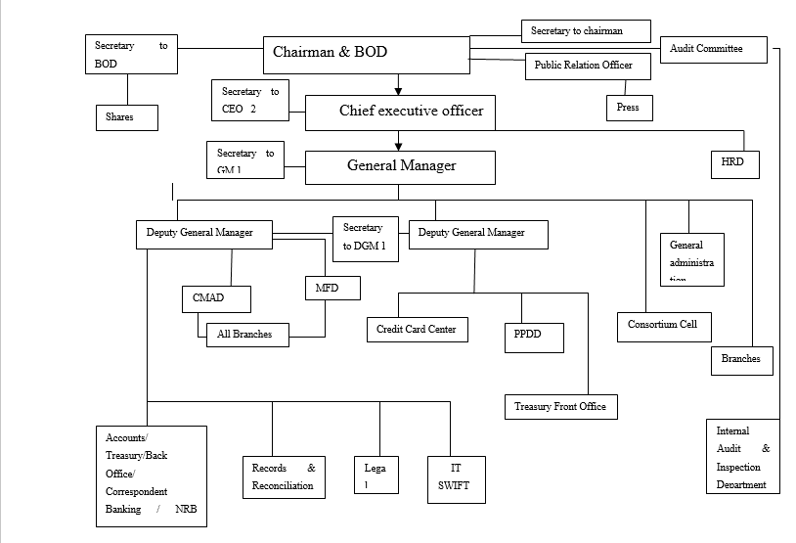

Organization Chart

Slide 5
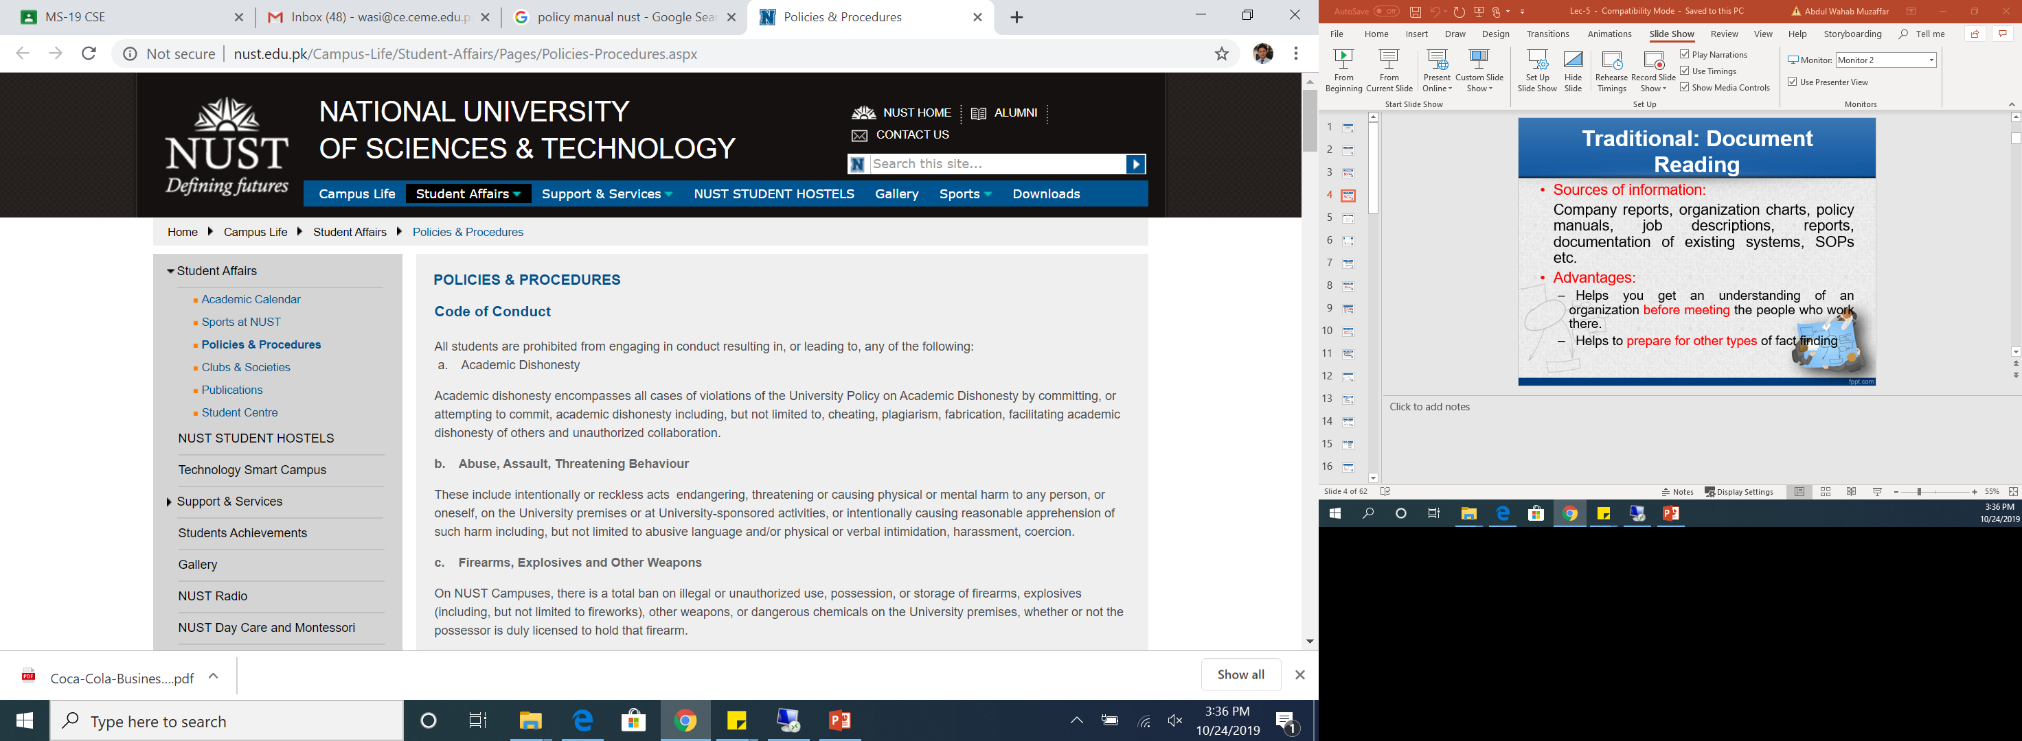
Policy Manual

Slide 6
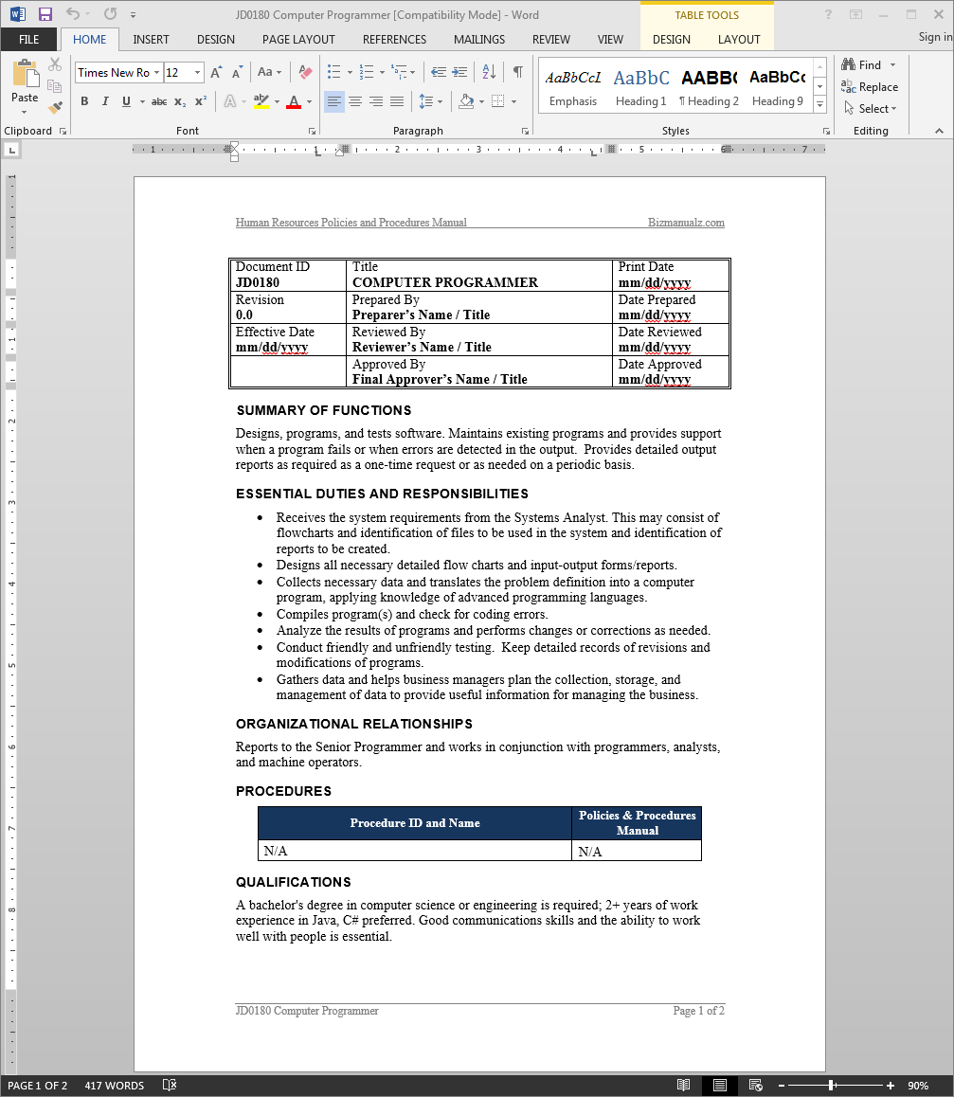
JD

Slide 7


Slide 8
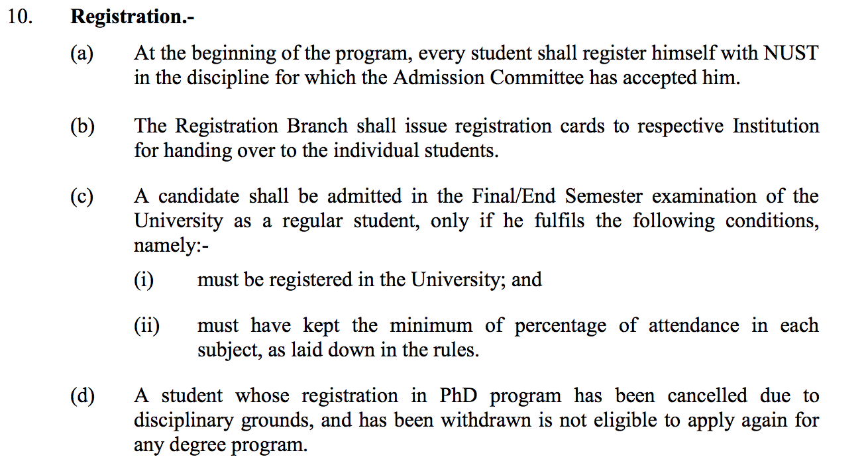
Can you find Software Requirements?

Slide 9
Document Reading
Disadvantages:
  Often do not match up to reality.
  May contain irrelevant detail;
  Appropriate for:
whenever you are not familiar with the organization being investigated.

Slide 10

INTERVIEWING
Simple and direct technique that can be used in most circumstances.
Types:
  Structured : pre-set agenda/questions
  Open-ended: no pre-set agenda
Precautions:
  Make sure that the biases of the interviewer do not interfere with a free exchange of information.
  We must not let our context (background) interfere with understanding the real problem to be solved

Slide 11
Context-Free Questions
Help us gain an understanding of the real problem without biasing the user's input.
Questions about the nature of the user's problem without context for a potential solution.
listen before attempting to invent or describe a potential solution.

Slide 12
Context-Free Questions
Listening gives us a better understanding of the customer's problem and any problems behind the problem.
E.g.
  What problems does this product solve?
  What problems could this product create?
  What environment is this product likely to encounter?

Slide 13
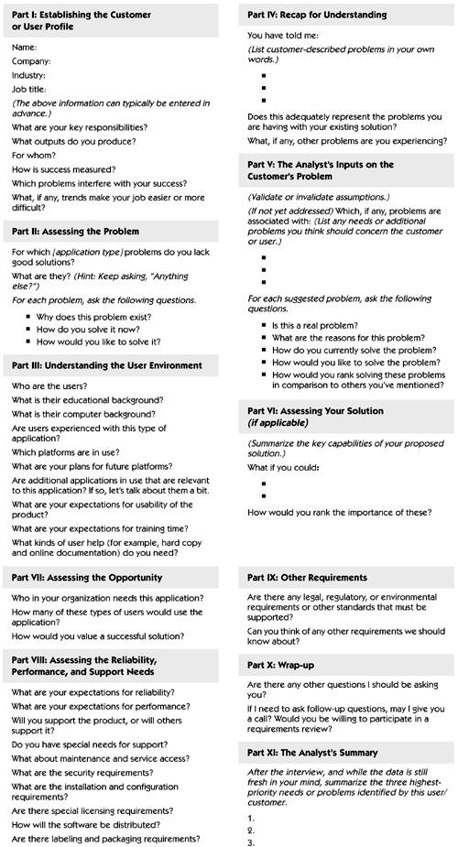
Context-Free Interview Template

Slide 14
Context-Free Interview Template

Slide 15
Context-Free Interview Template

Slide 16
Context-Free Interview Template

Slide 17
Context-Free Interview Template

Slide 18
Tips for Successful Interview
Prepare an appropriate context-free interview template.
Review the questions just prior to the interview.
Before the interview, research the background of the stakeholder and the company to be interviewed.
Jot down answers in your notebook during the interview.

Slide 19
Questionnaires
There is no substitute for an interview.
Although the questionnaire technique is often used and appears scientific because of the opportunity for statistical analysis of the quantitative results, the technique is not a substitute for interviewing.
problems.
  E.g. Relevant questions cannot be decided in advance.

Slide 20
Questionnaires
Difficult to follow up on unclear user responses.
Unreliable info

Slide 21
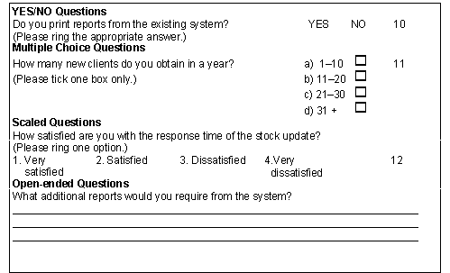

Slide 22
Questionnaires
However, the questionnaire technique can be applied with good effect as a supporting technique after the initial interviewing and analysis activity.
For example, if the application has a large number of existing or potential users and if the goal is to provide statistical input about user or customer preferences among a limited set of choices, a questionnaire can be used effectively to gather a significant amount of focused data in a short period of time.
Notes:
Corroborate : Supporting

Slide 23
GROUP: Requirements Workshops
May be the most powerful technique for eliciting requirements.
If we were to be given only one requirements elicitation technique—one that we had to apply in every circumstance, no matter the project context, no matter what the time frame—we would pick the requirements workshop.

Slide 24


Requirements Workshop
Gathers all key stakeholders together for a short but intensely focused period (1-2 days)
The use of an outside facilitator experienced in requirements elicitation can help ensure the success of the workshop.
Brainstorming is the most important part of the workshop.

Slide 25
Requirements Workshops
Can expose and resolve political issues that are interfering with project success.
The output, a preliminary system definition at the features level, is available immediately.
The workshop is facilitated by a team member or, by an experienced outside facilitator and focuses on the creation or review of the high-level features to be delivered by the new application.

Slide 26


Slide 27
Preparing for the Workshop
Sell the Concept
  communicate the benefits of the workshop approach to prospective members of the team.
Ensure the Participation of the Right Stakeholders
  These stakeholders will have already been identified if the team analyzed the problem properly.
Attend to Logistics
  Logistics involve everything from structuring the proper invitation to travel arrangements to the lighting in the workshop meeting room.
  If you approach logistics with a high degree of professionalism, it will be obvious to the attendees that this is indeed an important event, and they will act accordingly

Slide 28
Preparing for the Workshop
Provide Warm-Up Materials in Advance
  To prepare the attendees and also to increase productivity at the workshop session.

Slide 29
Choosing the Facilitator
It is recommended that the workshop be run by a non-stakeholder, someone outside the organization, who is unaffected by any particular outcome and has no role in the company other than to see a successful workshop outcome.
However, if this is not practical in your environment, the workshop could be facilitated by a team member if that person:
  Has received some training in the process
  Has demonstrated solid consensus-building skills
  Is pleasant and well respected
  Is strong enough to chair what could be a challenging meeting

Slide 30
Choosing the Facilitator
If the workshop is to be facilitated by a team member, that person must not contribute to the ideas and issues at the meeting.

Slide 31
Responsibilities of the Facilitator
Establish a professional tone for the meeting.
Start and stop the meeting on time.
Establish and enforce the "rules" for the meeting.
Introduce the goals and agenda for the meeting.
Manage the meeting and keep the team "on track."
Facilitate a process of decision and consensus making, but avoid participating in the content.
Manage any facilities and logistics issues to ensure that the focus remains on the agenda.
Make certain that all stakeholders participate and have their input heard.

Slide 32
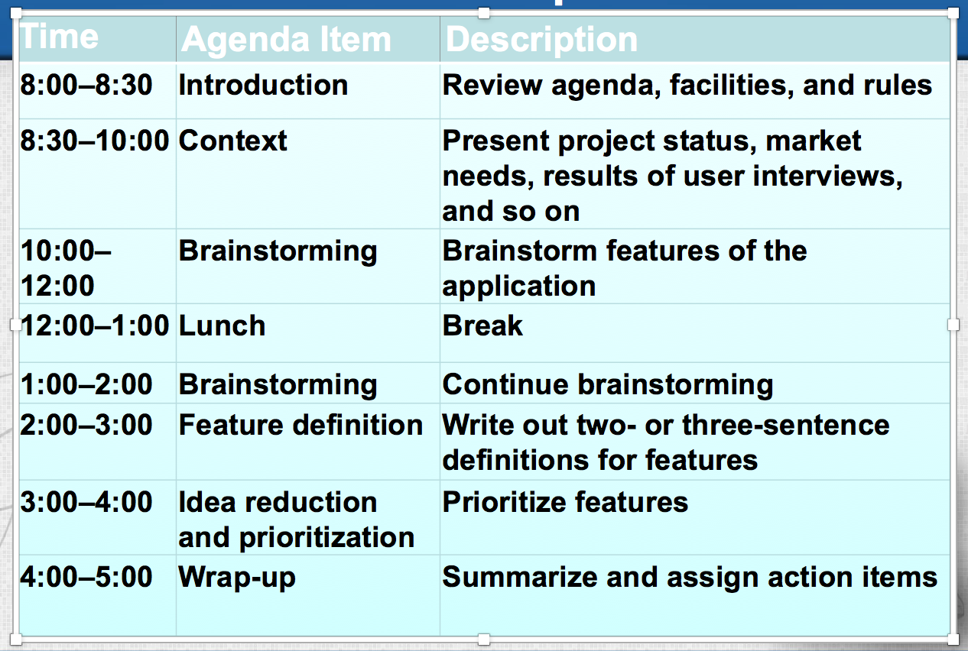
Sample Agenda for Requirements Workshop

Slide 33
Brainstorming
Involves both idea generation and idea reduction.
Various voting techniques may be used to prioritize the ideas created.
Although live brainstorming is preferred, Web-based brainstorming may be a viable alternative in some situations.

Slide 34
Brainstorming
The primary goal during idea generation is to define as many ideas as possible, focusing on breadth of ideas, not necessarily depth.
The primary goal during idea reduction is to analyze all the ideas generated.
  pruning, organizing, ranking, grouping, refining, and so on.

Slide 35
Storyboarding
Is extremely inexpensive
Is user friendly, informal, and interactive
Provides an early review of the user interfaces of the system
Is easy to create and easy to modify

Slide 36
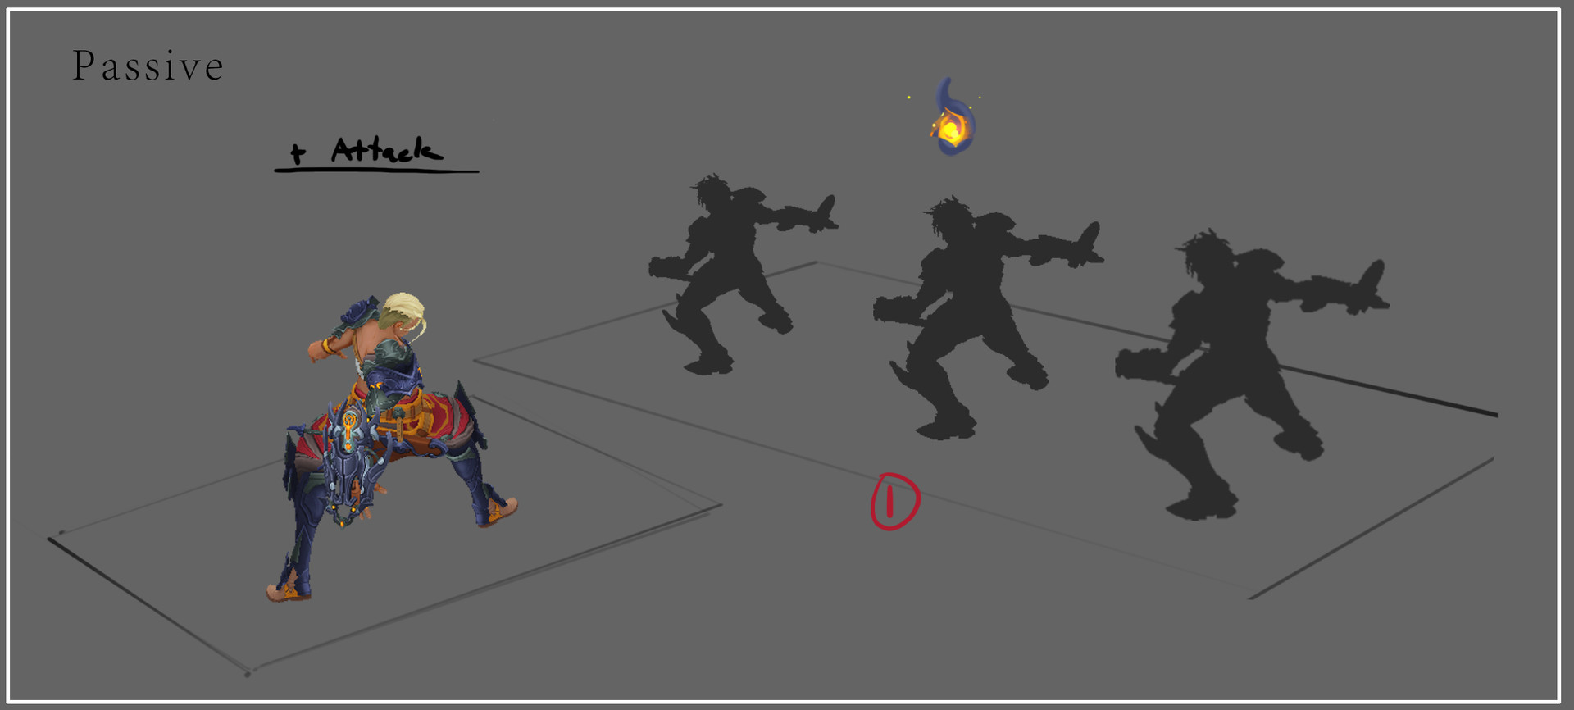
Types of Storyboards
Passive storyboards
  Tell a story to the user.
  They can consist of sketches, pictures, screen shots, or sample application outputs.
  In a passive storyboard, the analyst plays the role of the system and simply walks the user through the storyboard, with a "When you do this, this happens" explanation.

Slide 37
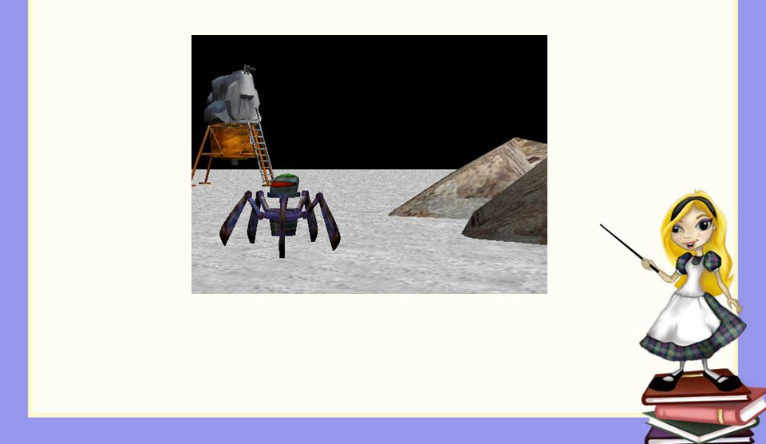
Types of Storyboards
Active storyboards
  Active storyboards are animated or automated, perhaps by an automatically sequencing slide presentation, an animation tool, a recorded computer script or simulation, or even a home-made movie.
  Active storyboards provide an automated description of the way the system behaves in a typical usage or operational scenario.

Slide 38
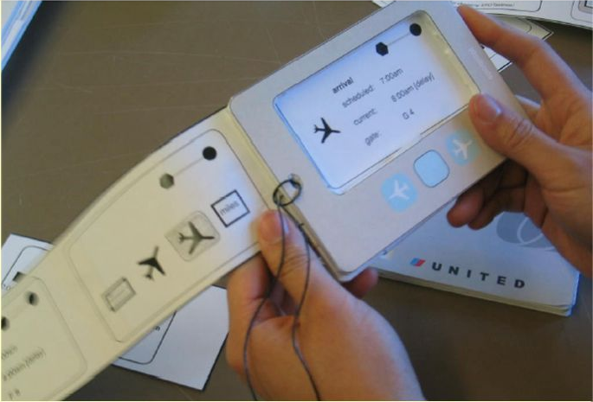
Types of Storyboards
Interactive storyboards
  Let the user experience the system in as realistic a manner as practical.
  They require participation by the user.
  Interactive storyboards can be simulations or can be advanced to the point of throwaway code.

Slide 39
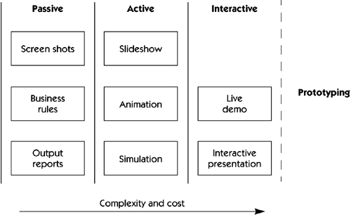
Types of Storyboards

Slide 40
Types of Storyboards
The choice of storyboarding technique will vary, based on the complexity of the system and the risk of the team's misunderstanding of what the system needs to do.
An unprecedented or particularly innovative system that has abstract and fuzzy definitions may even require multiple storyboards, moving from passive to interactive as the team's understanding of the system improves.

Slide 41
Storyboards
Storyboards for user-based systems deal with the three essential elements of any activity:
  Who the players are
  What happens to them
  How it happens

Slide 42
Storyboards
The who element:
  includes the users of the system, other systems, or devices
  in other words they are the actors that interact with the solution system we are defining.
The what element :
  represents the behavior of the users as they interact with the system as well as the behavior of the system as it interacts with the user.

Slide 43
Storyboards
  For users, the interaction is typically described via user input screens or data entry forms, outputs such as data or reports, or other types of input and output devices, such as buttons, displays, and monitors.
  For devices and systems, interaction will be performed via a software or hardware interface
The how element provides descriptions of how this interaction proceeds, showing events, states, and state transitions.

Slide 44
Tips for Storyboarding
Don't invest too much in a storyboard.
If you don't change anything, you don't learn anything. Make the storyboard easy to modify. You should be able to modify a storyboard in a few hours.

Slide 45
Tips for Storyboarding
Don't make the storyboard too functional.
Whenever possible, make the storyboard interactive.
The customer's experience of use will generate more feedback and will elicit more new requirements than a passive storyboard will.

Slide 46
Prototypes
Goal: check requirement sufficiency from direct user feedback, by showing reduced sketch of software-to-be in action
Prototype = quick implementation of some aspects

Slide 47
Prototypes
Throw-away prototype: prototype is thrown away
  The objective is to validate or derive the system requirements.
  The prototyping process starts with those requirements which are poorly understood
Evolutionary prototype: transformed towards efficient code
  The objective is to deliver a working system to end-users.
  The development starts with those requirements which are best understood.

Slide 48
Prototyping
Quick implementation:
  by use of very high-level programming language,
    Visual Programming
    GUI Development Toolkits
    COTS based development

Slide 49
Prototypes
Advantages:
  Concrete flavor of what the software will look like
=> clarify requirements, elicit hidden ones,.
  Other uses: user training, stub for integration testing, ...
Limitations:
  Does not cover all aspects
    missing functionalities
  ignores important non-functional requirements (performance, cost, ...)
  ‘Quick-and-dirty’ code, hard to reuse for software development

Slide 50
Observation and Ethno-methodology
Involves the analyst spending time with the organization and making detailed observations about its work practices.
Subsequent analysis of the observations can reveal vital information about the organization, which usually differs clearly from the one recorded in formal documents (manuals, handbooks) of the organization.
Notes:
Ethnomethodology is the study of methods people use for understanding and producing the social order in which they live

Slide 51


Slide 52
Observation and Ethno-methodology
Passive observation: no interference with task performers
  Watch from outside, record (notes, video), interpret
  Protocol analysis: task performers concurrently explain it
  Ethnographic studies: over long periods of time, try to discover emergent properties of social group involved
    about task performance + attitudes, reactions, gestures, ...

Slide 53
Observation and Ethno-methodology
Active observation:
  you get involved in the task, even become a team member

Slide 54
Observation and Ethno-methodology
May reveal ...
  tacit knowledge that would not emerge otherwise
  culture-specific aspects to be taken into account
Slow & expensive: to be done over long periods of time, at different times, under different workload conditions
Potentially inaccurate (people behave differently when observed)

